Slide 1
AGE,GENDER AND ETHNICITY(FACE DATA)
SHIVA SURYA PRAKASH.S
PGA-20
IMARTICUS(BENGALURU)

Slide 2
PROBLEM STATEMENT
By processing the image we have to predict the age ,ethnicity and gender of the person

Slide 3
DATA DESCRIPTION
This dataset includes a CSV of facial images that are labeled on the basis of age, gender, and ethnicity.
The dataset includes 27305 rows and 5 columns.

Slide 4
FEATURES DESCRIPTION
It consists of five features(columns) in the dataset
Age(Age of the person in the image)
Ethnicity(Specifies the ethnicity of the person) {0: "White", 1: "Black", 2: "Asian", 3: "Indian", 4: "Hispanic" }
Gender(gender of the person) { 0: "Male", 1: "Female" }
Imagename(name of the image)
PIXELS(Array to String of the image pixels)

Slide 5
STEPS
Mounting the Google Drive
Installing the keras tuner
Importing some of the basic libraries
Importing the Keras and Tensorflow libraries
Reading the dataset
Understanding the dataset

Slide 6
STEPS
Check the data types of variables
Checking the value counts of the dataset
Checking the shape of the data(Rows and Columns)
Checking for missing values
changing data type and doing scaling(for Pixels)
dropping img_name from dataframe

Slide 7
EXPLORATORY DATA ANALYSIS
Doing univariate and bivariate analysis
Checking the unique and the value counts of the gender , age and ethnicity
Plotting the countplot for gender(univariate analysis)
Plotting the distribution plot for age(univariate analysis)
Plotting the countplot for ethnicity and gender(bivariate analysis)

Slide 8
STEPS
Reshaping the data
Splitting the train and test from the dataset
Creating dummies for Ethnicity and Gender
Getting the continuous values for the Age
Splitting the Validation and test from the dataset

Slide 9
MODEL BUILDING
Building the model
Initializing the Convolution layer(Convolutional layers are the layers where filters are applied to the original image, or to other feature maps in a deep CNN. This is where most of the user-specified parameters are in the network. The most important parameters are the number of kernels and the size of the kernels).

Slide 10
MODEL BUILDING
Initializing the Hidden layer(A hidden layer in an artificial neural network is a layer in between input layers and output layers, where artificial neurons take in a set of weighted inputs and produce an output through an activation function. It is a typical part of nearly any neural network in which engineers simulate the types of activity that go on in the human brain.)
Initializing the final model
Compiling the model

Slide 11
HYPERPARAMETER TUNING
Instantiate the tuner and perform hypertuning
Hyperparameter tuning (to find the best params which gives the best accuracy)
The hyperparameter search is complete. The optimal number of units in the first densely-connected layer is 896 and the optimal learning rate for the optimizer is 0.0002255275563378355

Slide 12
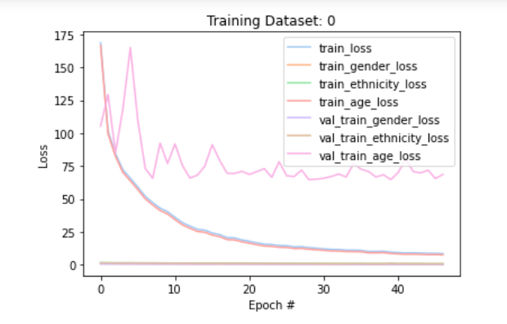
TRAINING DATASET LOSS

Slide 13
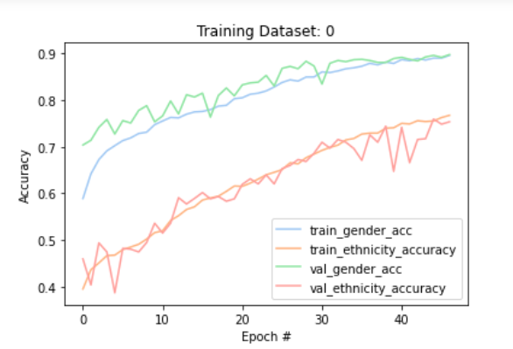
TRAINING DATASET ACCUARCY

Slide 14
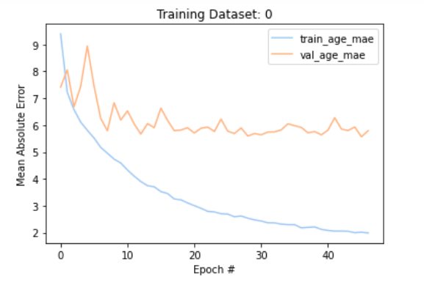
TRAINING DATASET OF MEAN ABSOLUTE ERROR

Slide 15
RESULT
We are doing the confusion matrix for checking the TP,FP,TN and FN
Accuracy of the Age is 88 percentage
Accuracy of the Ethnicity is 74 percentage
Mean absolute error of age is 5 percentage

Slide 16
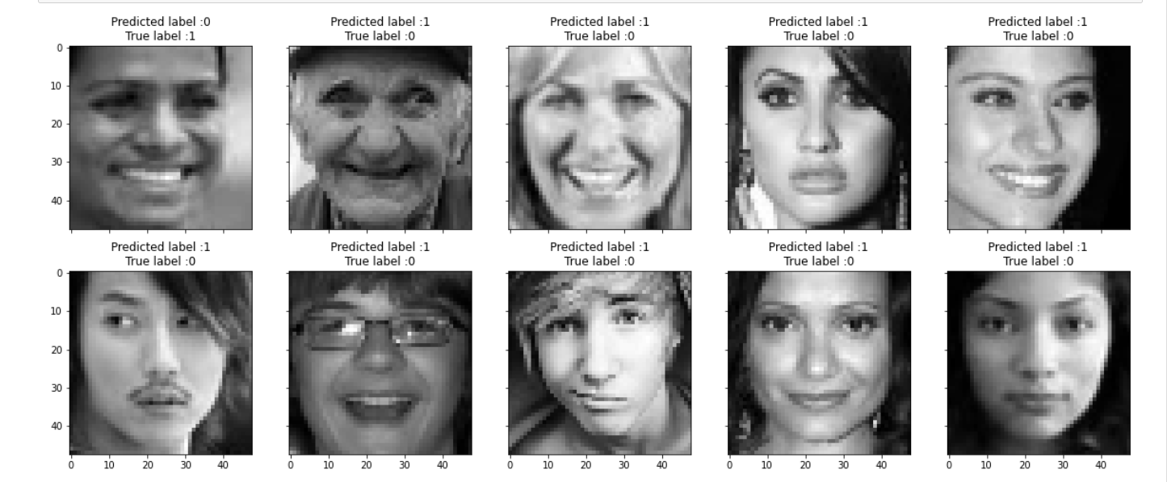
Top Error’s in Gender

Slide 17
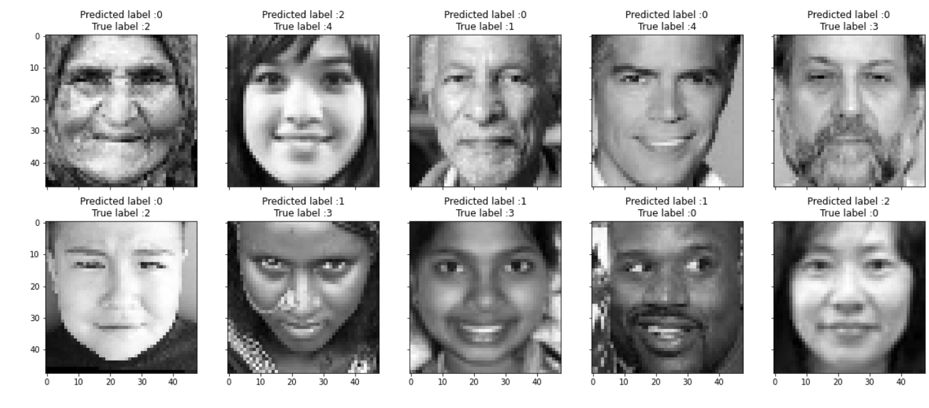
Top Error’s in Ethnicity

Slide 18
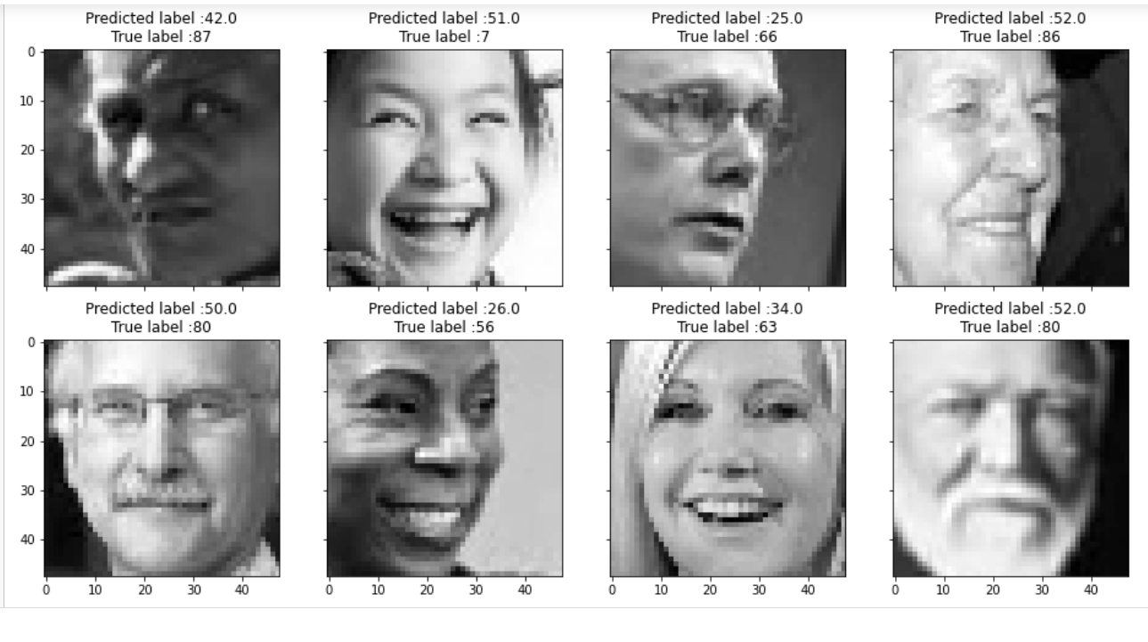
Top Error’s in Age

Slide 19
Key Finding
When it comes to binary classification the accuracy of the model is high
When it comes to multilabel classification the accuracy of the model is less compare to the binary classification
Before the hyperparameter tuning the accuracy of the model is less
After the hyperparameter tuning the accuracy is increased

Slide 20
Helpful for Business
By categorizing the gender ,ethnicity and age.we can show the products or Advertisement to the specific person

